Slide 1
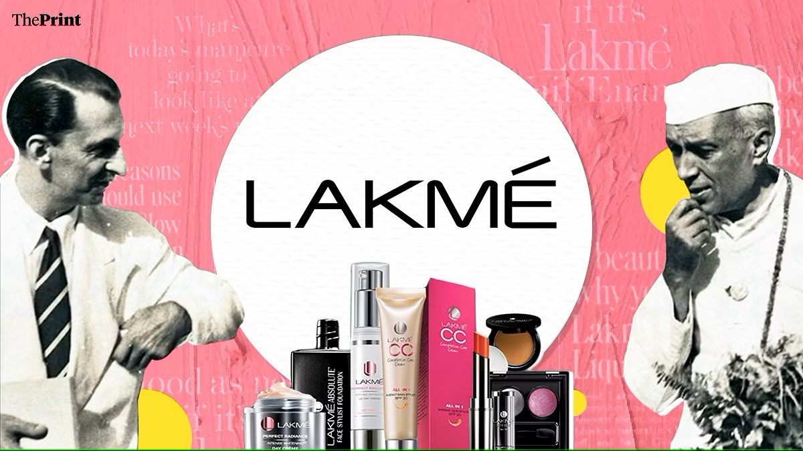
DIGITAL MARKETING MANAGEMENT PROJECT – TERM 1st
Made by : Ayushi Sharma
GIVEN BY: YOGITA MAM

Slide 2
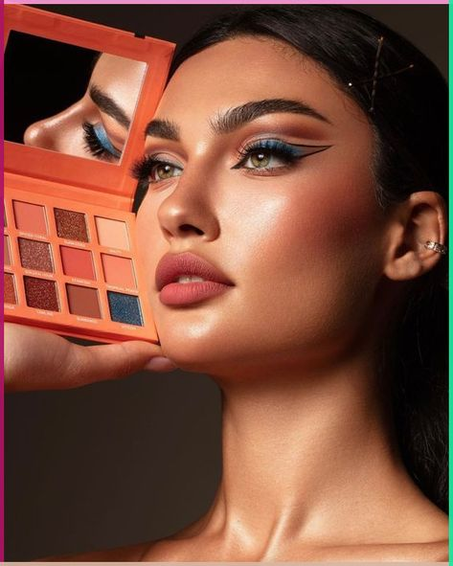
Digital Marketing Process for LAKME
This presentation outlines LAKME's digital marketing strategy. It will delve into their goals, target audience, and the methods used to reach their target market. This will highlight how they strategically allocate their budget and utilize various platforms to achieve success.
as

Slide 3
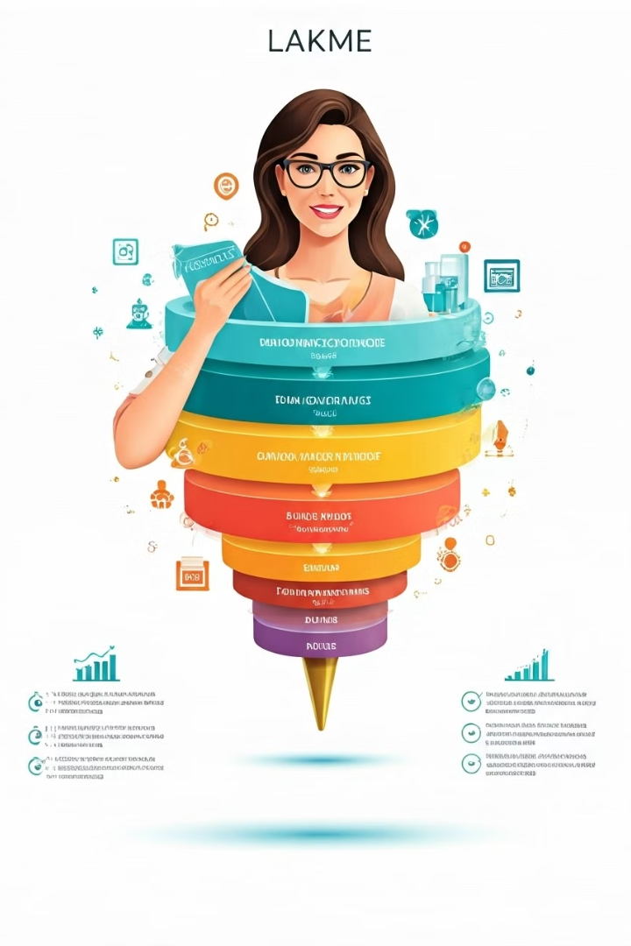
Objectives of LAKME's Digital Marketing
1
Increase Brand Awareness
2
Drive Sales and Revenue
Expand brand recognition and reach a wider audience through various digital channels. This involves promoting LAKME's products and services to a broader consumer base.
Generate more sales and revenue through online channels. This includes promoting products, creating compelling offers, and leveraging e-commerce platforms.
3
Enhance Customer Engagement
4
Improve Brand Loyalty
Build deeper relationships with existing customers and potential buyers through interactive content, personalized experiences, and valuable information.
Foster brand loyalty by providing exceptional customer service and offering engaging experiences that encourage repeat purchases and brand advocacy.

Slide 4
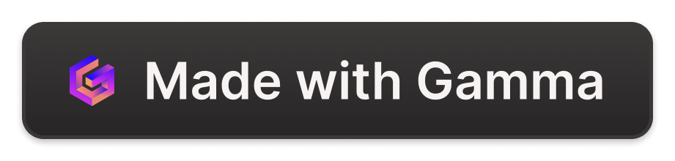
LAKME's Buyer Persona
Demographics
Psychographics
Lifestyle
Women aged 18-45 years old, with a focus on millennials and Gen Z. Diverse ethnic backgrounds and socioeconomic statuses. Strong interest in beauty and fashion.
Tech-savvy and active social media users. Seek authentic and reliable information. Value quality products and a positive self-image. Appreciates personalized experiences.
Active lifestyles and busy schedules. Open to new trends and seek convenience. Prioritize ethical and sustainable brands. Seek high-quality products at affordable prices.

Slide 5
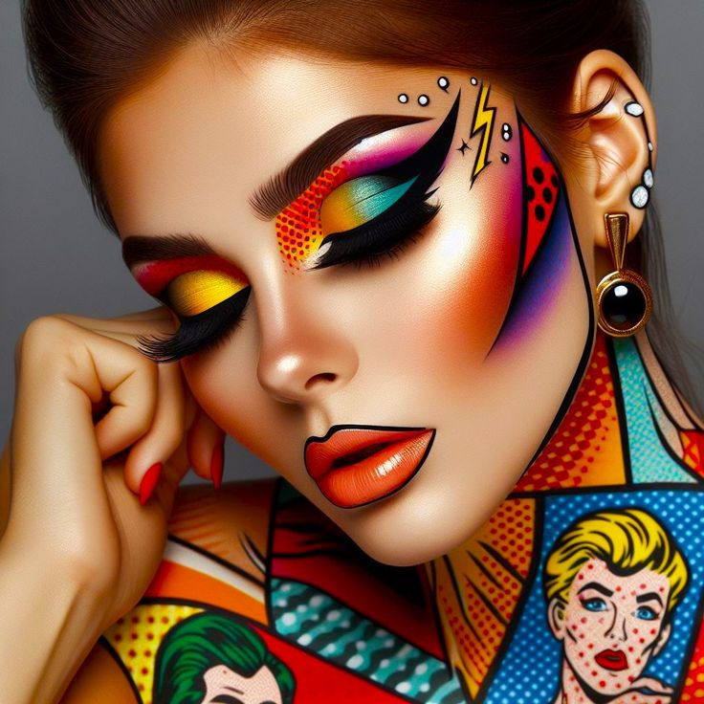
Lakme Buyer’s Persona
Demographics:
Name : AYESHA SHARMA
Age: 18-35 years
Gender: Predominantly female, but a growing interest among males
Income Level: Middle to upper-middle class
Location: Urban and semi-urban areas, with a significant presence in Tier 1 and Tier 2 cities in India
Education: College-educated or pursuing higher education
Occupation: Students, working professionals (especially in corporate and creative fields), young entrepreneurs

Slide 6
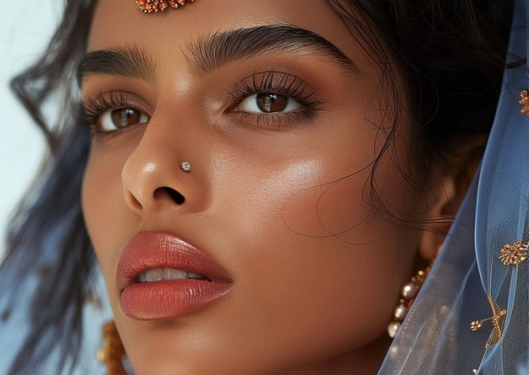
Psychographics:
Lifestyle:
Fashion-conscious and trend-oriented
Values appearance and personal grooming
Active social life, often attending events, parties, and social gatherings
Personality:
Confident, ambitious, and outgoing
Values quality and brand reputation
Open to experimenting with new looks and products
Interests:
Beauty and skincare
Fashion and lifestyle trends
Social media and influencers
Fitness and wellness

Slide 7
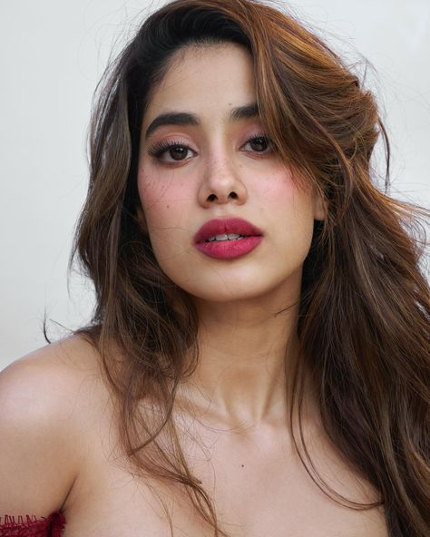
Behavioral:
Buying Habits:
Regularly shops for beauty and skincare products both online and offline
Tends to follow beauty influencers and recommendations
Looks for products that offer quality, innovation, and value for money
Prefers brands that are easily accessible in terms of availability and price
Brand Loyalty:
High brand loyalty due to positive past experiences with Lakme products
Likely to try new products launched by Lakme
Decision-Making Process:
Researches products online through reviews and social media
Values recommendations from friends, family, and influencers
Considers product ingredients, benefits, and brand reputation before purchasing

Slide 8
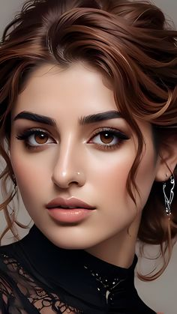
Preferred Channels:
Online:
E-commerce platforms like Nykaa, Amazon, Flipkart
Social media platforms (Instagram, YouTube) for tutorials and reviews
Offline:
Retail stores, beauty salons, and Lakme Beauty Lounges
Shopping malls and cosmetic sections in large retail chains
Marketing Messaging:
Brand Values:
Trust, quality, and innovation
Empowering individuals to express their beauty confidently
Key Messages:
"Unleash your inner beauty with Lakme's innovative range."
"Trusted by millions for a flawless look."
"Stay ahead in style with Lakme's trendy and high-quality products."
This buyer persona helps Lakme tailor its marketing strategies, product development, and customer engagement efforts to meet the needs and preferences of its target audience effectively.

Slide 9
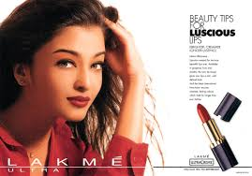
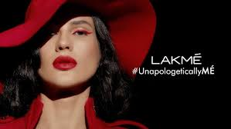
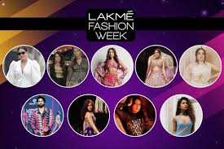
LAKME's Digital Marketing Strategies: Past, Present, and Future
1
Past
Focused on traditional advertising and brand building through television and print media. Limited online presence and social media engagement.
2
Present
Strong focus on digital channels: social media marketing, influencer collaborations, content creation, and e-commerce. Engaging with customers through interactive platforms.
3
Future
Investing in emerging technologies like augmented reality (AR) and virtual reality (VR) for immersive experiences. Adopting data-driven strategies for personalized marketing.

Slide 10
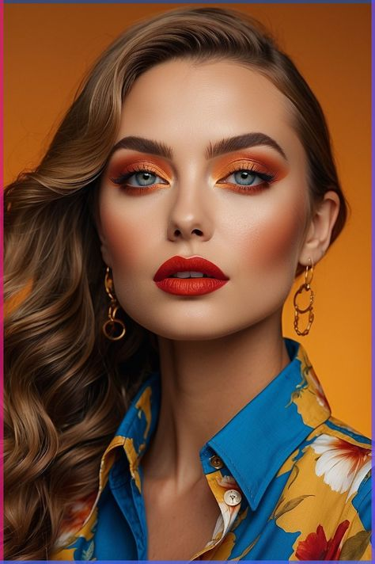
LAKME's Investment in Paid, Earned, and Owned Media
Type
Description
Investment
Paid Media
Paid advertisements on social media, search engines, and other platforms
50%
Earned Media
Public relations, media coverage, influencer marketing, and social media engagement
30%
Owned Media
LAKME's website, blog, and social media channels
20%

Slide 11
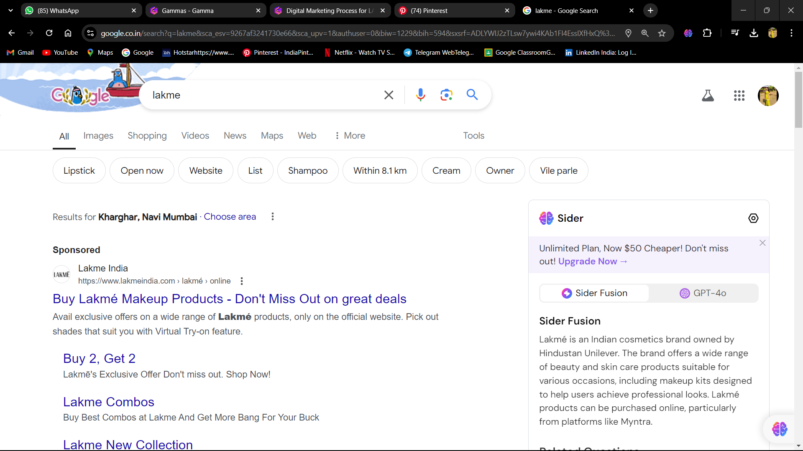
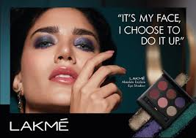
LAKME's Digital Presence: Microsite or Website
Product Showcase
Interactive Features
Showcase LAKME's diverse product range with high-quality images, detailed descriptions, and customer reviews.
Include virtual try-on tools, personalized recommendations, and educational content for an engaging user experience.
E-commerce Integration
Blog and Content
Allow customers to easily purchase LAKME products directly from the website, providing a convenient shopping experience.
Regularly publish blog posts on beauty tips, product reviews, and industry trends to engage the target audience.

Slide 12

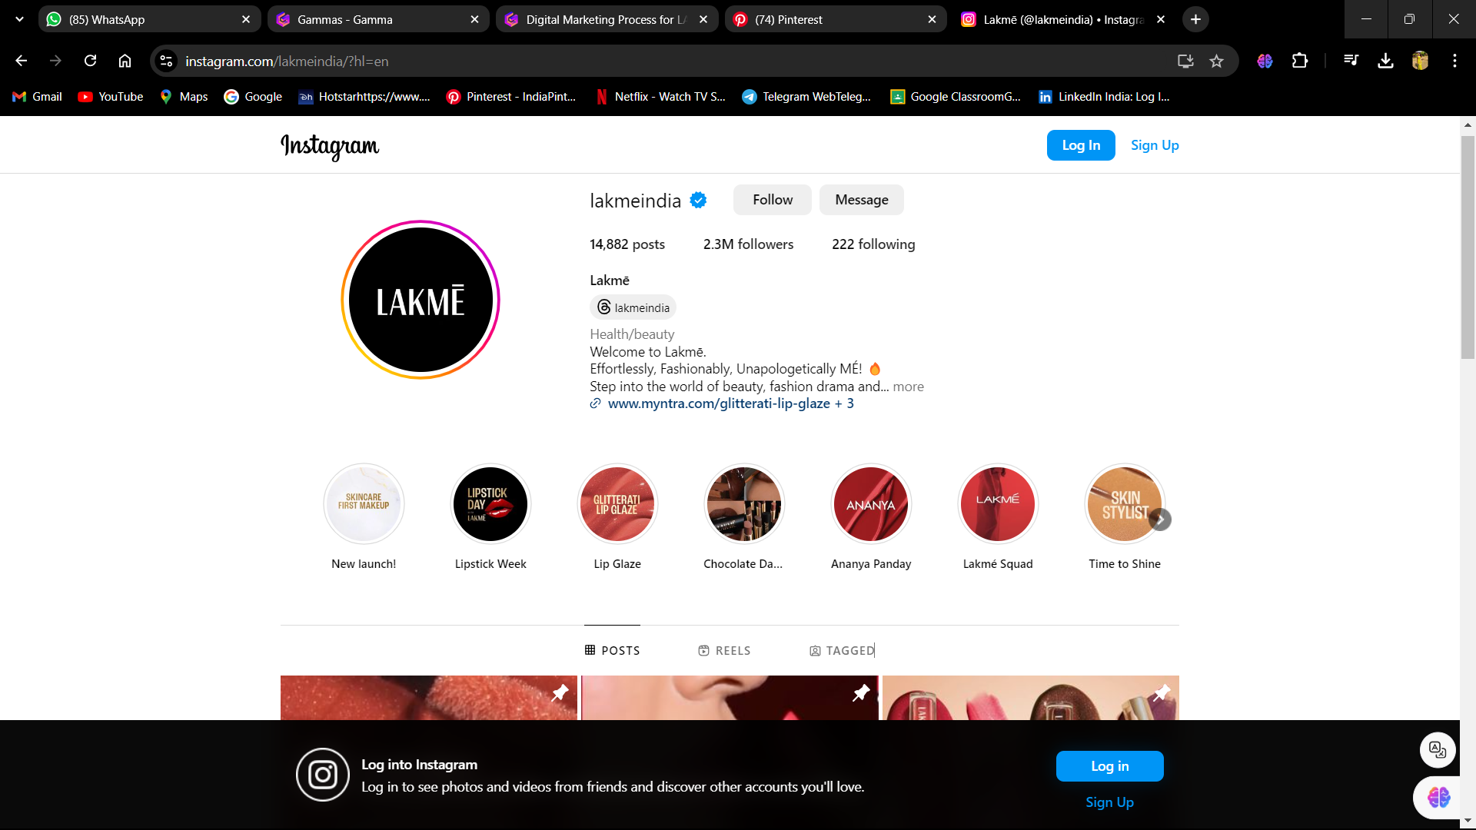




LAKME's Social Media Platforms
Facebook
Instagram
Focus on sharing engaging content, running contests, and interacting with customers.
Utilize high-quality visuals, behind-the-scenes content, and influencer collaborations to connect with the target audience.
YouTube
Twitter
Create informative videos, product tutorials, and behind-the-scenes content to engage viewers and build brand awareness.
Stay current with beauty trends, respond to customer inquiries, and participate in industry discussions.

Slide 13
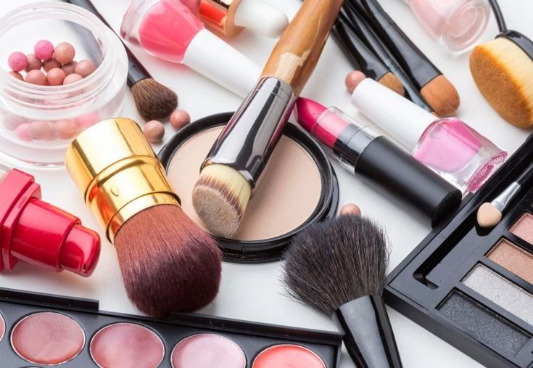




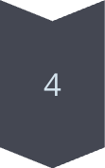
LAKME's Digital Marketing Budget Allocation and Calendar
Q1
Focus on launching new products, promoting seasonal collections, and increasing brand awareness.
Q2
Emphasize influencer marketing, social media campaigns, and paid advertising to drive sales.
Q3
Maximize holiday campaigns, offer limited-time promotions, and engage customers with interactive content.
Q4
Promote gift sets, launch festive campaigns, and focus on customer retention through loyalty programs.

Slide 14
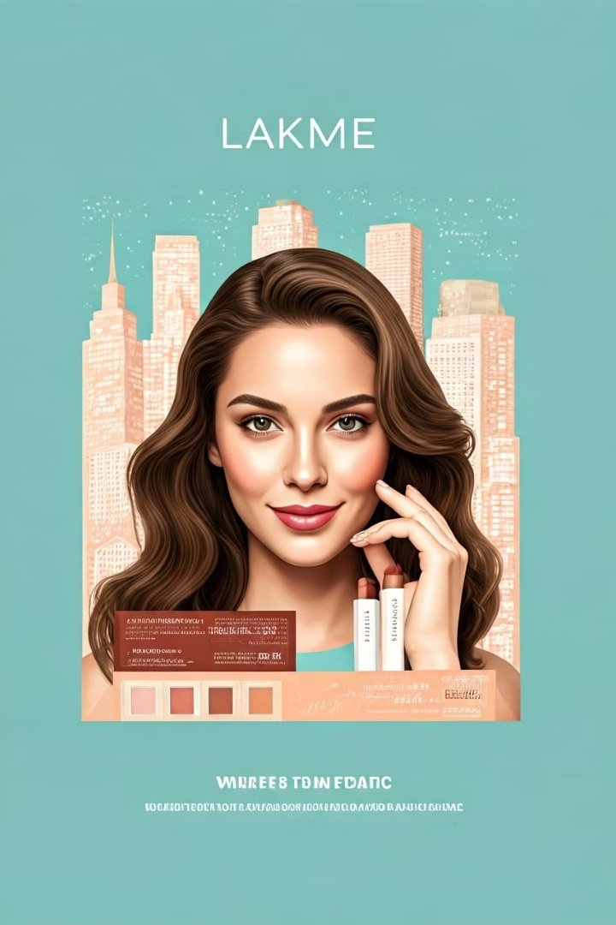
Conclusion
LAKME's digital marketing strategy effectively leverages various channels to achieve its objectives. By understanding its target audience, implementing data-driven strategies, and adapting to evolving trends, LAKME continues to grow its digital presence and reach a wider audience.

